Slide 1



dmarc
View in Power BI
Last data refresh:
3/7/2018 3:08:17 PM Romance Standard Time
Downloaded at:
3/12/2018 8:21:27 PM Romance Standard Time

Slide 2
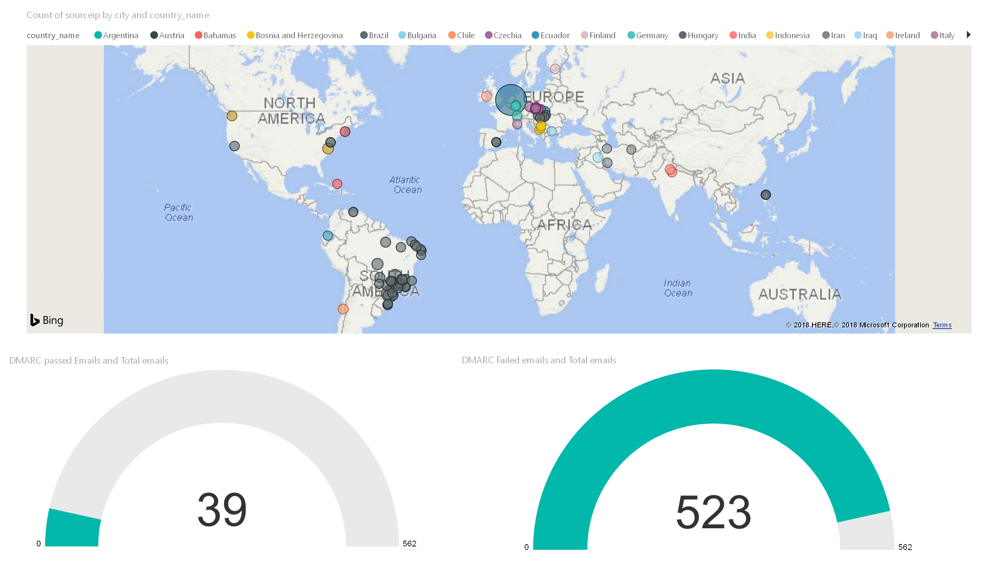

Slide 3
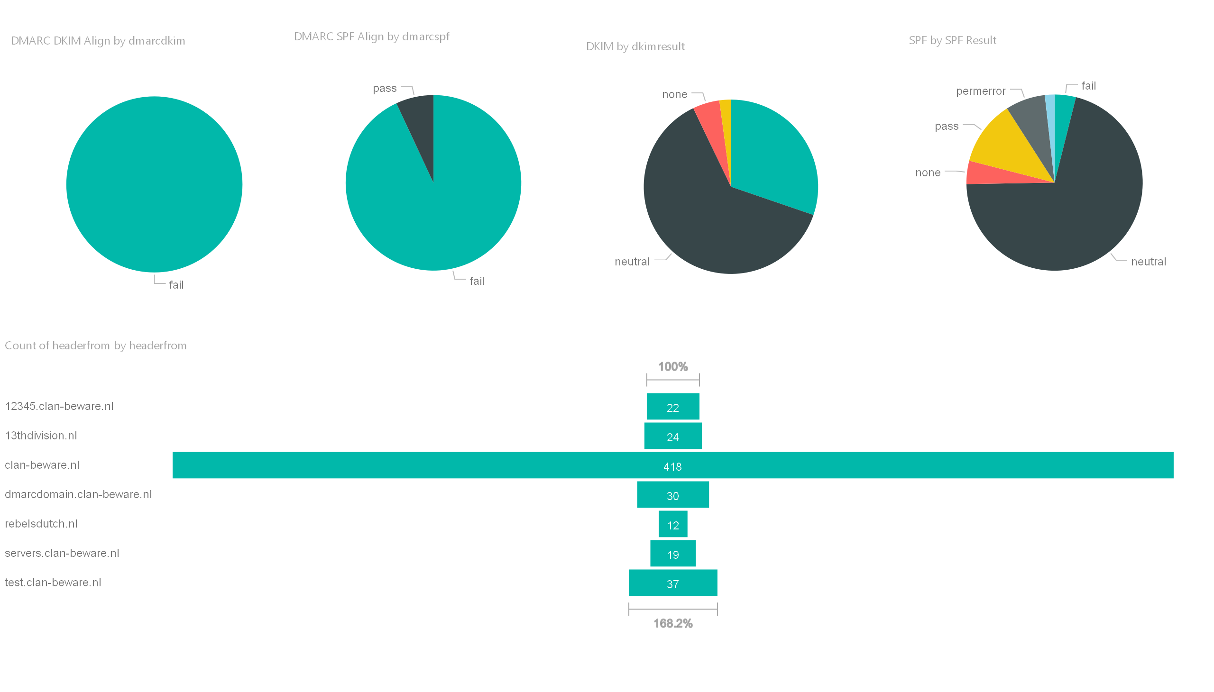

Slide 4
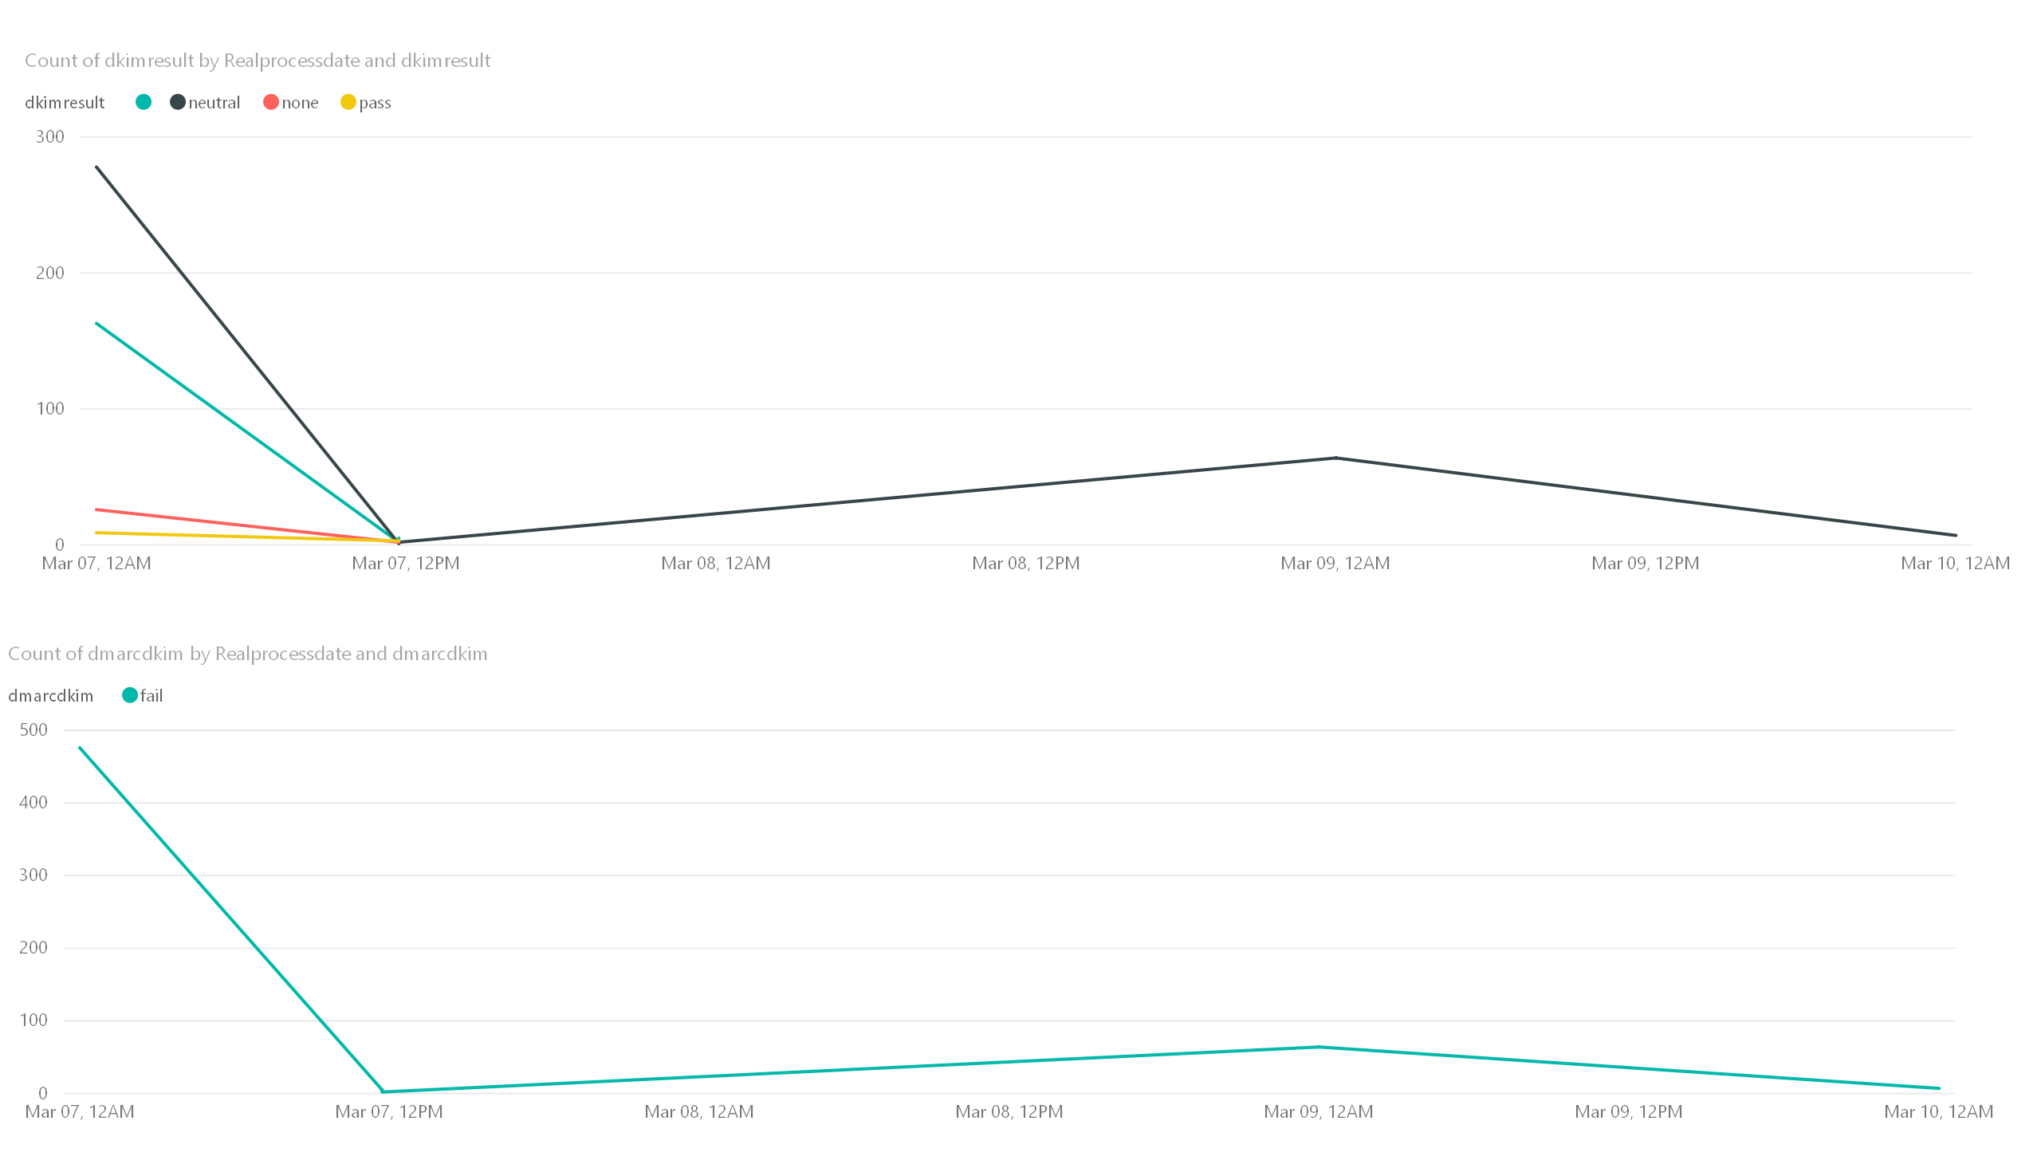

Slide 5
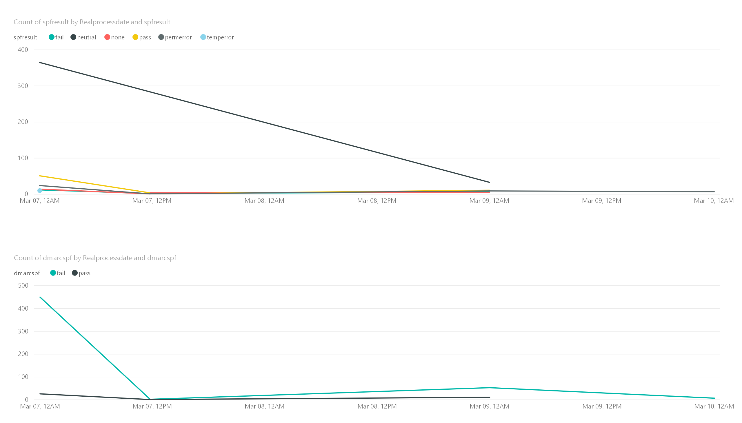

Slide 6
